Slide 1
The Ace of Data
DAB103 - Analytics Tools & Decision Making
Section - 004

Slide 2





Group Members
Bhakti Bhatt
Apurv Sathwara
Dhruvin Raval
Vismay Lad
Shraddha Kolte

Slide 3
BackGround/Motivation
In the recent times, during pandemic many businesses were closed, many people lost jobs, commercial world was all upside down. The only industry that survived was the IT industry, many IT companies saw this as an opportunity and few also upscaled themselves. Work from home was introduced and this was like a boon to many people as well as companies.
This is an era of Digitalization - Data is the most important factor and hence, IT sector will be proceeding towards new opportunities further.

Slide 4
Problem statement
To get some insight on how IT sector is growing in different technologies and departments. Also, what are the various types of employment opportunities in the market depending on experience, technology, salary etc.

Slide 5
Project Proposal
We have some analysis on the trends and patterns of job opportunities in the IT sector of a country that can be useful to understand which technology, job experiences are useful to grab a position in a company.

Slide 6
Citation
Dataset taken from Kaggel
Author: Parul Pandey

Slide 7
Dataset description
The dataset has data of anonymous salary survey that has been conducted annually in the EU region in recent two years.
It includes categorical and numerical variables like date, age, city, position, experience, salary, technical languages, employment status, contract, company size & type etc.
There are results of EDA and visualizations that help in describing the dataset.

Slide 8
Dataset description
Target
IT Professionals
Computer & IT Students
Other Students Interested in Technologies
Dataset
Categorical Variables
Timestamp
Gender
City
Position
Seniority Level
Technical Language
Employment Status
Contract duration
Main Language
Company type
Lost Job
Numerical Variables
Age
Total years of Experience
Years of Experience in Germany
Yearly brutto salary
Bonus+Stocks
Annual brutto 1yr ago
Bonus+Stocks 1yr ago
Vacation days

Slide 9
Exploratory Data Analysis (EDA)

Slide 10
how was the data collected ?
An anonymous survey has been conducted annually since 2015 among European IT specialists with stronger focus on Germany. This year many respondents volunteered to participate in survey The data has been made publicly available by the authors.
The dataset contains rich information about the salary patterns among the IT professionals in the EU region and offers some great insights.
An accompanying article - IT Salary Survey December 2020 has also been published which goes deeper into the findings.

Slide 11
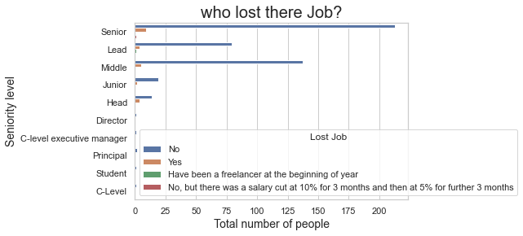
data that is highly correlated with each other

Slide 12
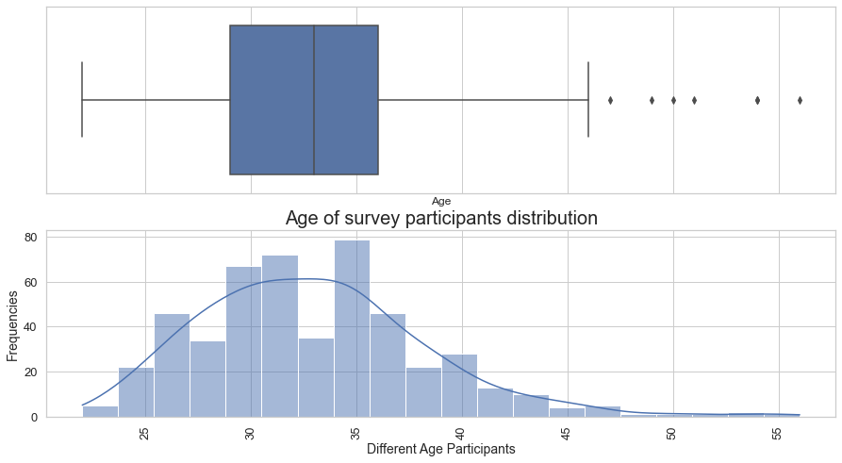
preliminary visualizations

Slide 13
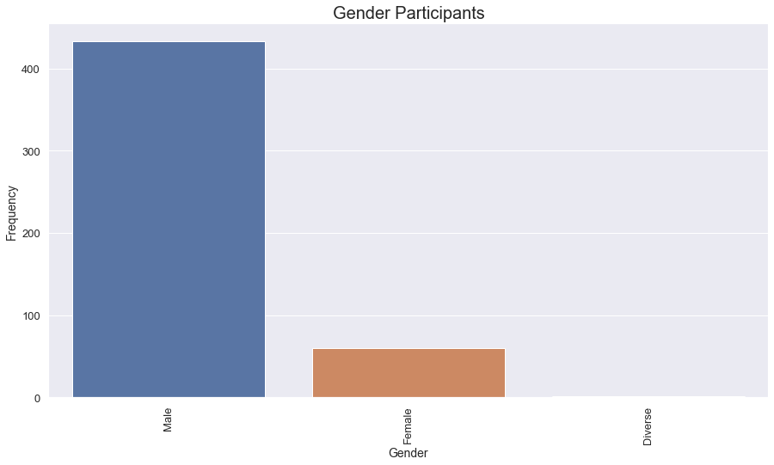
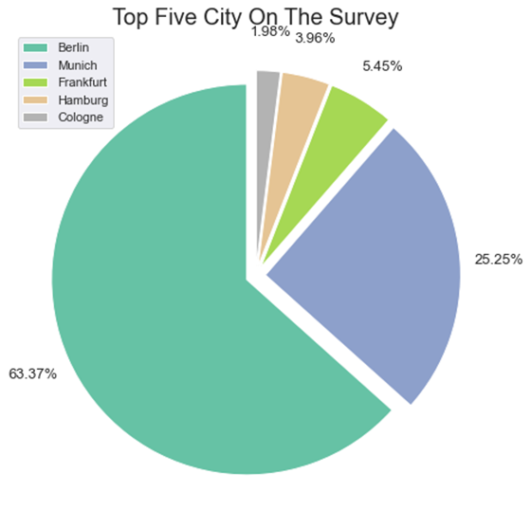

Slide 14
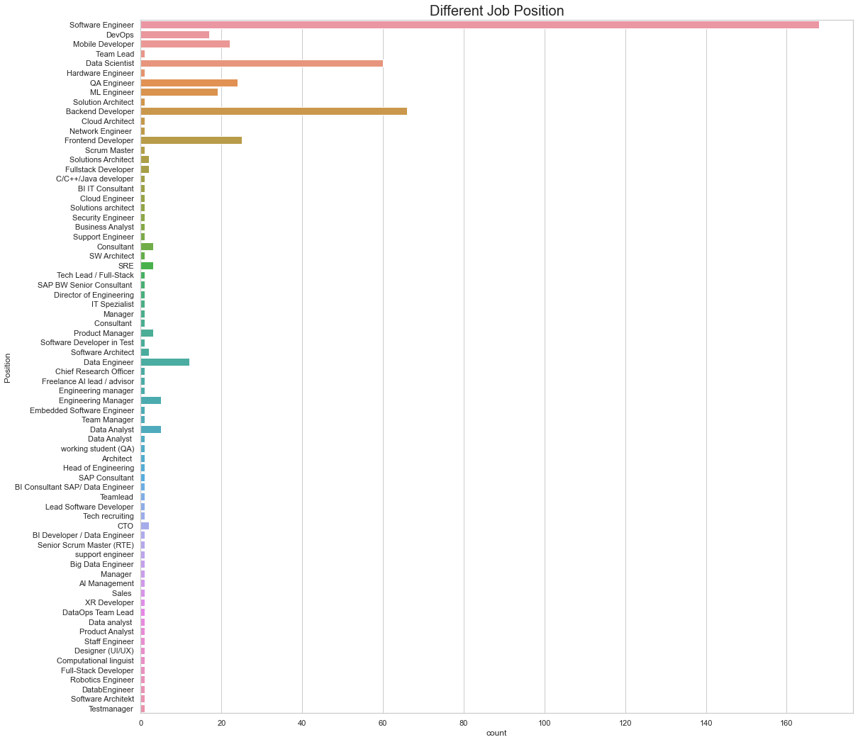

Slide 15
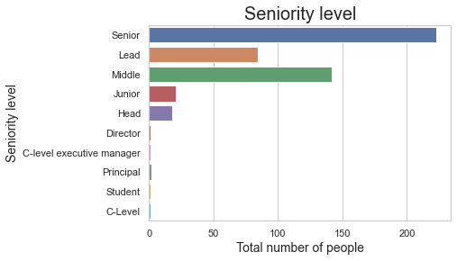

Slide 17
Data Transformation & Cleaning
The dataset was not clean with regards to Null values, extra spaces, special characters and incorrect data types.
Cleaning up euro sign, convert data type of “yearly_brutto_salary”, “annual_brutto_salary”,”total_years_of_experience” and “years_of_experience_in_Germany” from object to float using replace.
Cleaning up "euro sign (€)","comma (,)" and " bvg only " to convert data type of "bonus+stocks" from object to float for better understanding.
The column "bonus + stocks" are numeric values and one of the columns having " bvg only " was difficult to identify and work with, so we removed it, as it had no impact on the analysis.

Slide 18
Data ANALYSIS:
ANSWER TO INDIVIDUAL ANALYSIS QUESTIONS

Slide 19


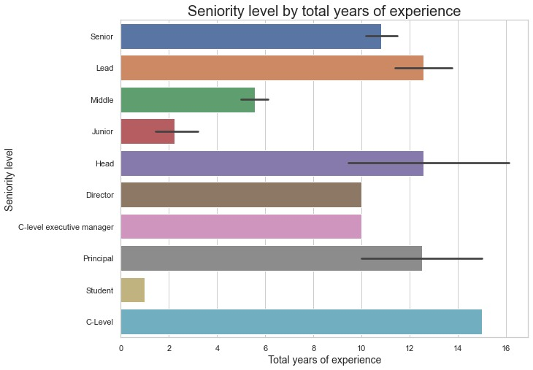
How much experience does an employee have with their respective seniority level?
ANSWER: The employees with more total years of experience are at C-level seniority, following with Principal, Head and Lead. The least experienced are the Students and Juniors.

Slide 20
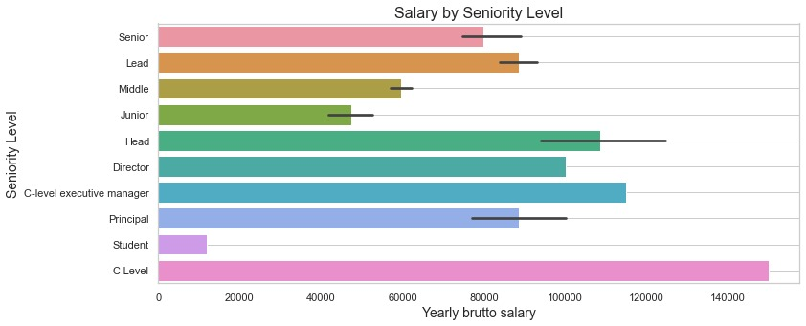
How much salary is earned by the seniority level of the employee?
ANSWER: The visualization clearly shows that the range of salary is up to 140000 which is earned by C-level Seniority. The minimum is below 20000 earned by students. The mid range is in between 40000 – 120000 earned by majority of employees.

Slide 21
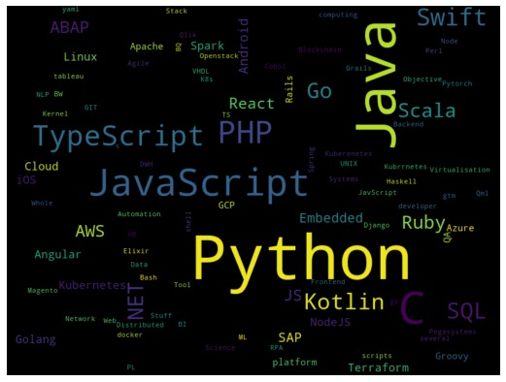
Which are the most popular top 5 technologies contributing to the growth of IT field?
ANSWER: The top 5 technologies are Python, Java, JavaScript, TypeScript and PHP that contribute towards the growth of IT field.

Slide 22
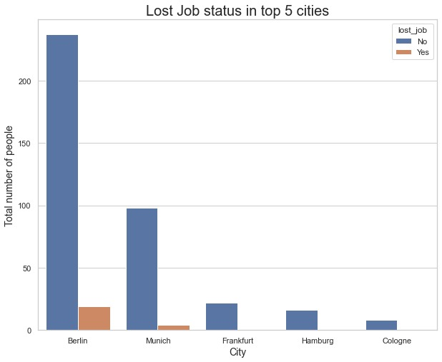
How Many Employees LOST their JOBS IN top 5 cities OF EU?
Answer: Many people sustained their jobs during pandemic, only a few in the city of Berlin and Munich lost their jobs.

Slide 23
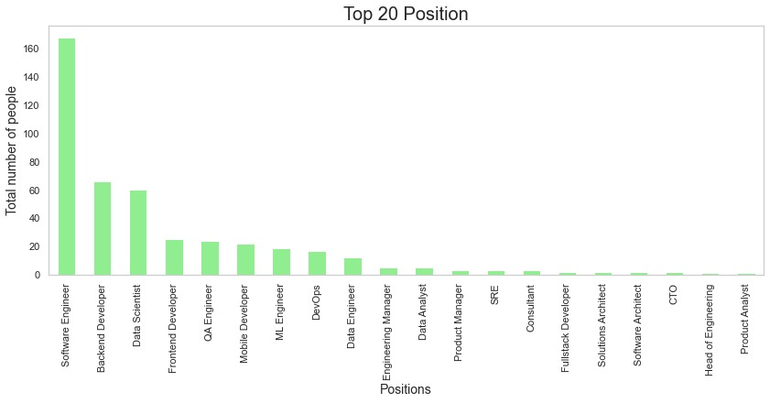
What are the top 20 positions in the field?
Answer: Considering top 20 positions in an IT company many employees are at Software Engineer’s Position, whereas the least number of employees are at a position of Product Analyst, rest are as shown in the visualization.

Slide 24
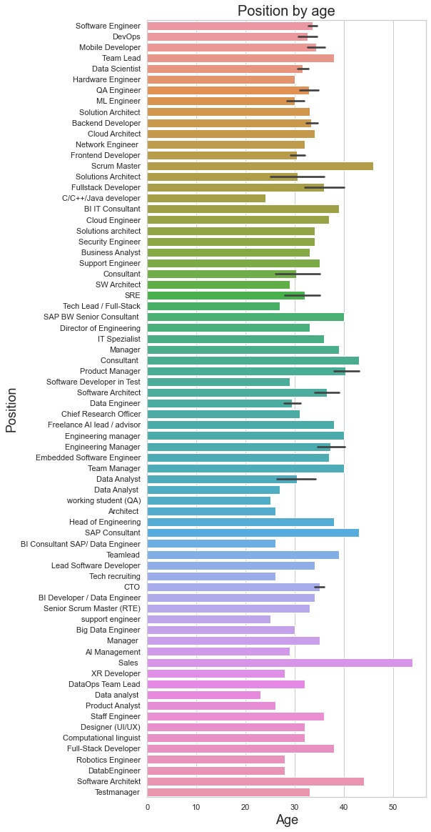
WHAT IS THE POSITION OF THE EMPLOYEE IN THE COMPANY WITH RESPECT TO THEIR AGE?
ANSWER: The employees in the age group of around 40-50 hold positions like Scrum Master, Consultant, SAP Consultant, Sales and Software Architects.

Slide 25
Conclusions
According to the total years of experience the level of seniority increases and so does the salary.
Top technologies in IT companies like Python, Java etc can be used to upscale themselves to sustain in the field.
IT industry could be seen as one of the reliable industries as not many people lost their jobs during pandemic.
Employees having technical skills are more in number at positions like Software Engineer, Backend Developer and Data Scientist etc.

Slide 26
recommendations
We can recommend that a student or a new joiner could learn the latest technologies like Python and Java. They could also be in a team lead by an experienced employee to understand how the industry works exactly.
This might lead to a reliable and growing career path in the cities like Berlin, Munich, Frankfurt etc in EU earning up to 140000 salary in later stages of life, or might be even more in the future.

Slide 27
CITATIONS
Dataset : Kaggle
Code: Referenced from Kaggle and actually done by us.

Slide 28
Github Link
Thank you!!

